Slide 1
Kotlin… Some interesting bits! (For a Java Developer)
Extension Functions, Destructuring declarations and Scope Functions

Slide 2
Everything that I’m about to tell you has already been explained by people much smarter than me. Read the Kotlin Docs!
https://kotlinlang.org/docs/home.html
Thank you for
coming to my
TED Talk

Slide 3


Who am I?
Some random person Ben Dale once met
I’m now working for myself, so:
No disclaimers necessary
I can describe myself as a Software Engineer (no fancy titles necessary)

Slide 4

I’m not a Kotlin Developer
I’ve passed a Kotlin technical interview
And then another
And another
And I’m currently working with Kotlin
But I’m not a Kotlin Developer

Slide 5

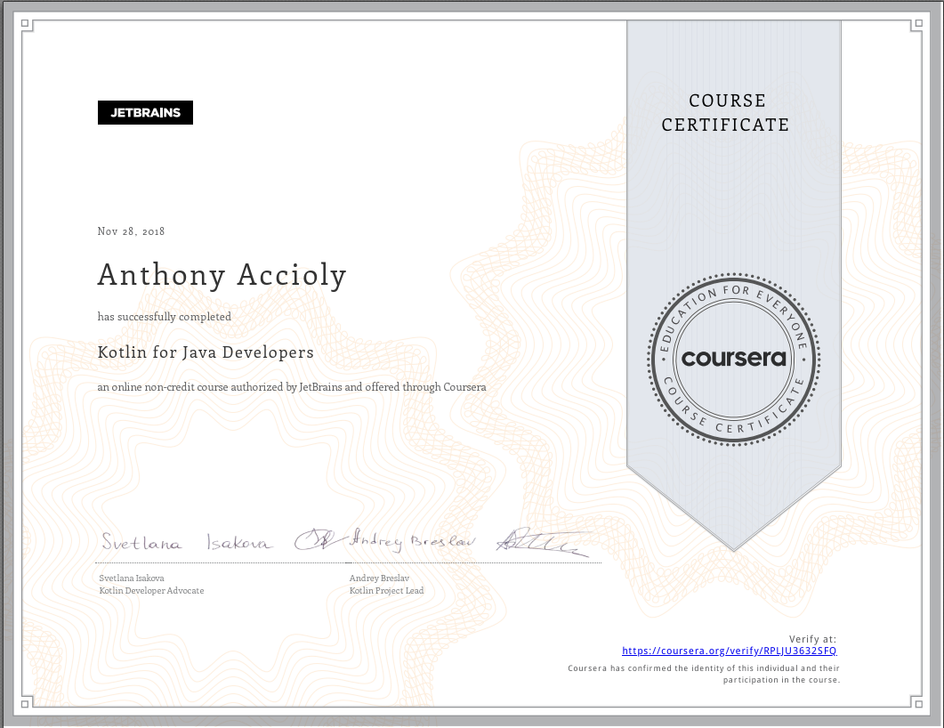
My path as a non-Kotlin developer
I’ve read the book
I took an online course by JetBrains:
https://www.coursera.org/learn/kotlin-for-java-developers

Slide 6

But I’m kind of a Java Developer
I also wrote a lot of Scala code
And, as everyone knows:
(Long unnecessary explanation about obviously ironic statement)
Andrey’s slides: https://www.slideshare.net/abreslav/2022-may-shoulders-of-giants-amsterdam-kotlin-dev-daypdf
Kotlin Channel: https://www.youtube.com/c/Kotlin

Slide 7


Okay… Kotlin
Or actually: Java

Slide 8
How would you implement “racecar”.isPalindrome()?

Slide 9
You can’t! Well…
public final class StringUtils {
private StringUtils() {
throw new UnsupportedOperationException(
"This is a utility class and cannot be instantiated");
}
public static String reverse(String s) {
return new StringBuilder(s).reverse().toString();
}
public static boolean isPalindrome(String s) {
return s.equals(reverse(s));
}
}
public static String reverse(String s) {
return new StringBuilder(s).reverse().toString();
}
public static boolean isPalindrome(String s) {
return s.equals(reverse(s));
}
Or use Project Lombok’s @UtilityClass

Slide 10

Trouble?
String is (and should remain) immutable
Utility classes all over the place
Code without context
Apache Commons Lang StringUtils class has ~10k lines

Slide 11
Extension functions to the rescue

Slide 12

Kotlin functions!
fun isPalindrome(string: String): Boolean {
return string == string.reversed()
}
Top-level function
Single-expression function
Return type is optional
fun isPalindrome(string: String): Boolean =
string == string.reversed()
fun isPalindrome(string: String) =
string == string.reversed()

Slide 13

But we can still do better!
fun String.isPalindrome() =
this == this.reversed()
Extension functions!
Call direct on a string
Compiles to a static method
FileStrings.kt → Default class StringsKt
Can be customized
Can be instantiated from Java (reference). Well, nothing is perfect!
@file:JvmName("KotlinStringUtils")

Slide 14
How would you implement String.firstAndLast()?

Slide 15
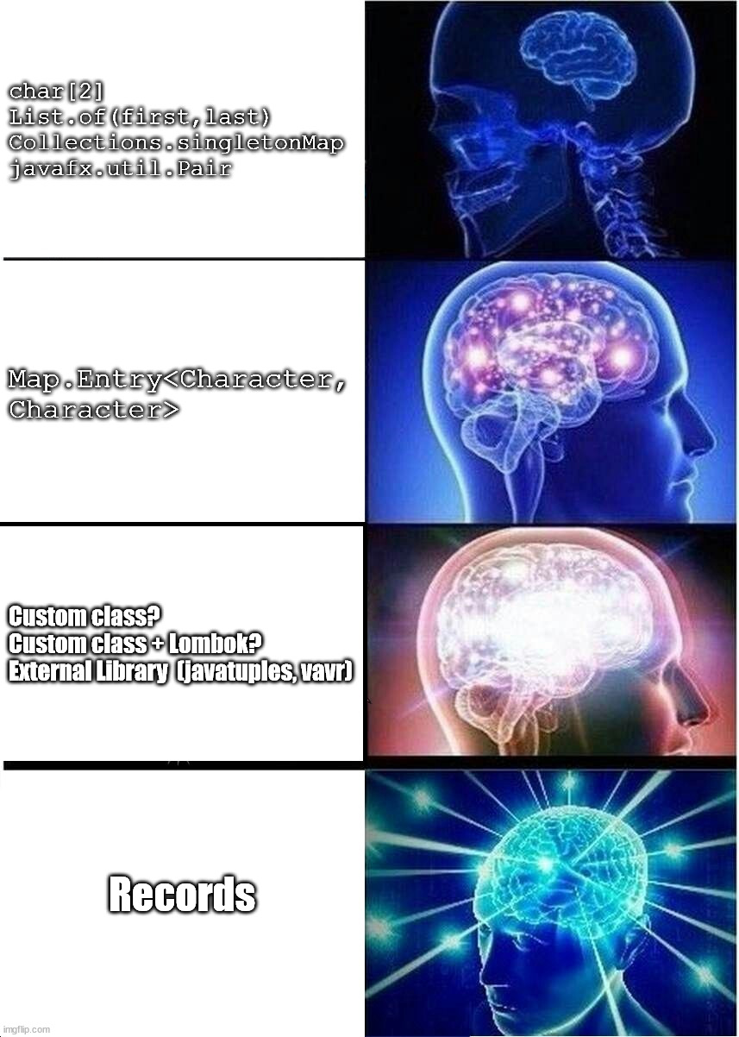
Records are Okay…ish!
record FirstAndLast(char first, char last) {
}
public static FirstAndLast firstAndLast(String s) {
return new FirstAndLast(
s.charAt(0),
s.charAt(s.length() - 1));
}
char[2]

Slide 16
Destructuring declarations

Slide 17
Kotlin can do something similar
data class FirstAndLast(val first: Char, val last: Char)
fun String.firstAndLast(): FirstAndLast =
FirstAndLast(first(), last())
But with better syntax
fun `returns first and last characters at once`() {
val input = "behind the scenes"
val (first, last) = input.firstAndLast()
first shouldBe 'b'
last shouldBe 's'
}
Also…
Backticks for method names with spaces
Infix notation for matchers
Kotest
Great way to introduce Kotlin

Slide 18
Destructuring declarations
Behind the scenes:
You can implement your own
Or use Pair
Kotlin used to have Tuples but… Discontinued - RIP!
Use underscore if you don’t care:
Very useful with collections and lambdas
operator fun component1() = first
operator fun component2() = last
fun String.firstAndLast(): Pair<Char, Char> =
first() to last()
val (first, _) = input.firstAndLast()
fun initials(firstName: String, lastName: String) =
"${firstName.first()}.${lastName.first()}"
val names = mapOfNames.map { (fn, ln) ->
initials(fn, ln)
}

Slide 19
Scope functions

Slide 20
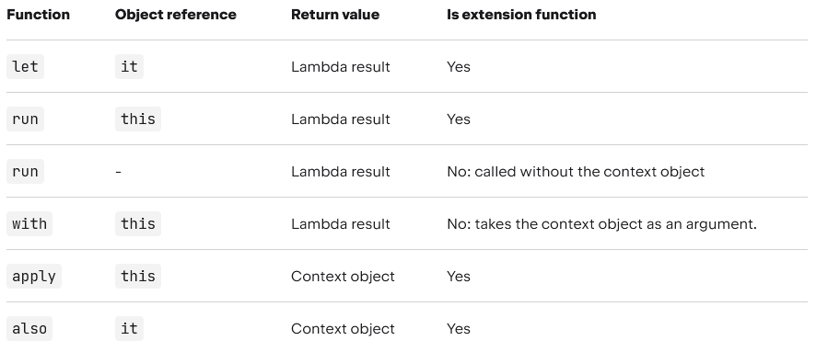
Speaking of lambdas… Scope Functions
Run a block of code against an object and lets you chain operations
Idiomatic, but prone to abuse

Slide 21
val jackson = Person("Michael", "Jackson", 50)
val result = jackson.copy(lastName = "Jordan", age = 59)
.let { jordan -> // Temporary variable for Michael Jordan
jordan.firstName shouldBe "Michael"
jordan.lastName shouldBe "Jordan"
jordan.age shouldBe 59 // Michael Jordan is 59 as of 16/06/2022
jackson// Forwards Michael Jackson, despite operating on Michael Jordan
}.apply {
age += 13
}.also { // Useful for logging and additional effects
it.age shouldBe 63 // Michael Jackson would be 63 as of 16/06/2022
}.run {
age += 1
val mjInitials = initials(firstName, lastName)
"By 29 August 2022 $mjInitials would be $age years old"
}
with(result) {
shouldBeSingleLine()
shouldContain("64")
shouldBe("By 29 August 2022 M.J. would be 64 years old")
}

Slide 22

Interesting usages and other goodies
?.let to skip through null
run without a receiver to give a scope to variables
also for logging
takeIf and takeUnless null based filtering
use Kotlin equivalent of try-with-resource
Result Try like type
Arrow types

Slide 23






Questions?
https://www.linkedin.com/in/aaccioly
https://stackoverflow.com/users/664577
https://a.accioly.7rtc.com
a.accioly (at) pm (dot) com
Slides will be available at:
https://github.com/aaccioly-demos/source-talks-on-kotlin-3 (Soon)
Kotlin… Some interesting bits! (For a Java Developer) © 2022 by Anthony Accioly is licensed under CC BY-SA 4.0

